Slide 1
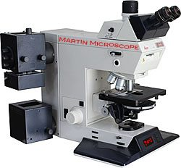
4-differential Interference contrast microscope
Is used to study of non-dyed living cells Examples of cells studied in this type of microscope are dividing cells.

Slide 2
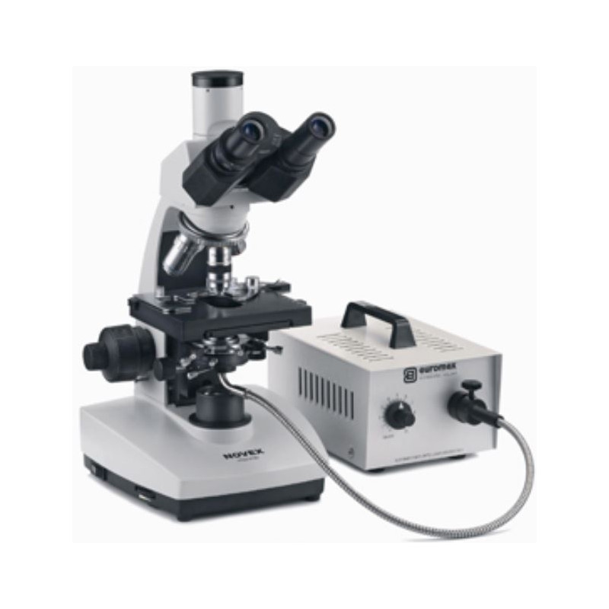
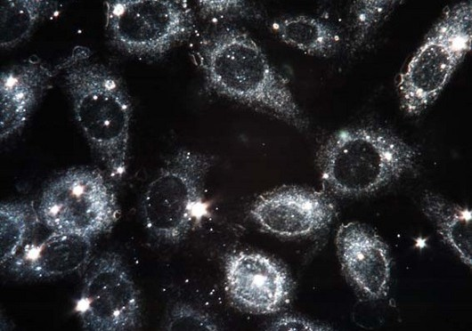
Dark Field Microscope
Is a technique used to observe unstained samples causing them to appear brightly lit against a dark, almost purely black, background. Examples of cells studied with this type of microscope are blood cells, algae and prokaryotes

Slide 3
6-Polarization Microscope
The work of this microscope depends on the fact that the parts of the cell differ in their degree of absorption or reversal of polarized light. This microscope used to study bifurcation structures such as (mitotic spindle, myosin filaments, and green plastids).

Slide 4
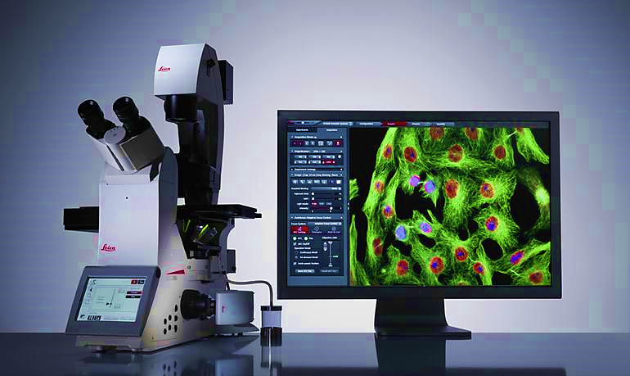
7-Fluorescence Microscope
Used to study the cellular components that appear sparkling when illuminated by ultraviolet radiation, such as molecules of chlorophyll and nucleic acid. The type of lenses made in this microscope is quartz instead of glass because the glass does not allow ultraviolet light to pass through.

Slide 5
B-Electron Microscope includes:
1-Scanning electron microscope (SEM)
2-Transmission electron microscope (TEM)
1- Scanning electron microscope (SEM)
-Electron beam is focused using a magnetic field.
- SEM provides a 3-D image.
- Gives information about external features of specimen. Much higher resolution and magnification than possible in LM

Slide 6
2- Transmission electron microscope (TEM)
- Electron beam is focused using a magnetic field.
- TEM provides a 2-Dimage.
- Revels internal cell structure.
- High resolution, high magnification.

Slide 7
Comparison between Light and Electron Microscope

